Slide 1
RECOVERY WEEK 8 REPORT

Slide 2
OBJECTIVES
DESIGN AND TESTING OF REMOTE SWITCHING CIRCUIT
IMPLEMENTATION OF REMOTE SWITCHING SOFTWARE
CAMERA STREAM

Slide 3
PI CAMERA
A SUCCESSFUL CAMERA VIDEO STREAM WAS ACHIEVED
STREAM ON THE PI 2W WAS INCONSISTENT; TROUBLESHOOTING ONGOING

Slide 4
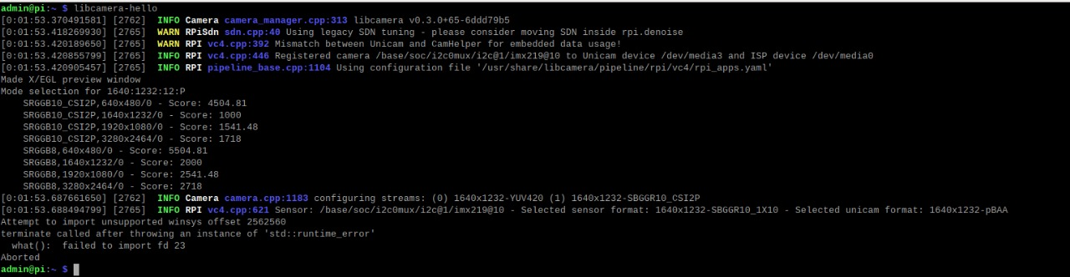

Slide 5
REMOTE SWITCHING
TWO SWITCHES: PHYSICAL ONE ON THE ROCKET BODY FOR POWERING ESP32
REMOTE ONE CONTROLLED ON THE GROUND STATION USING MQTT AND RF
PREVENT MISFIRES DURING LOADING OF THE AVIONICS
THE OTHER SENSORS ARE POWERED BY A COMMAND FROM THE ESP32 DURING ARMING

Slide 6
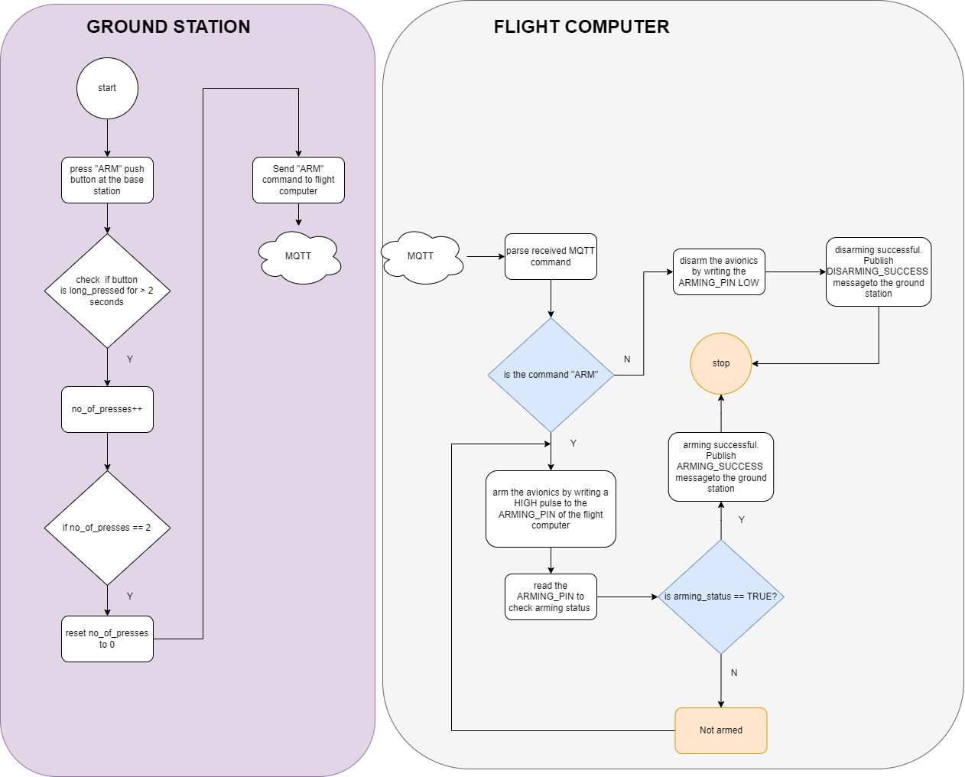
ARMING FLOWCHART

Slide 7
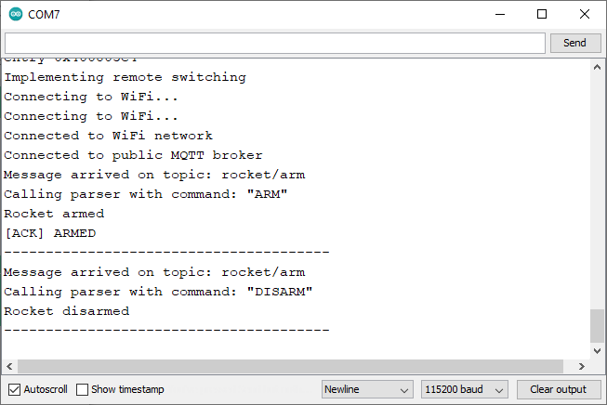
MQTT ARDUINO SERIAL

Slide 8
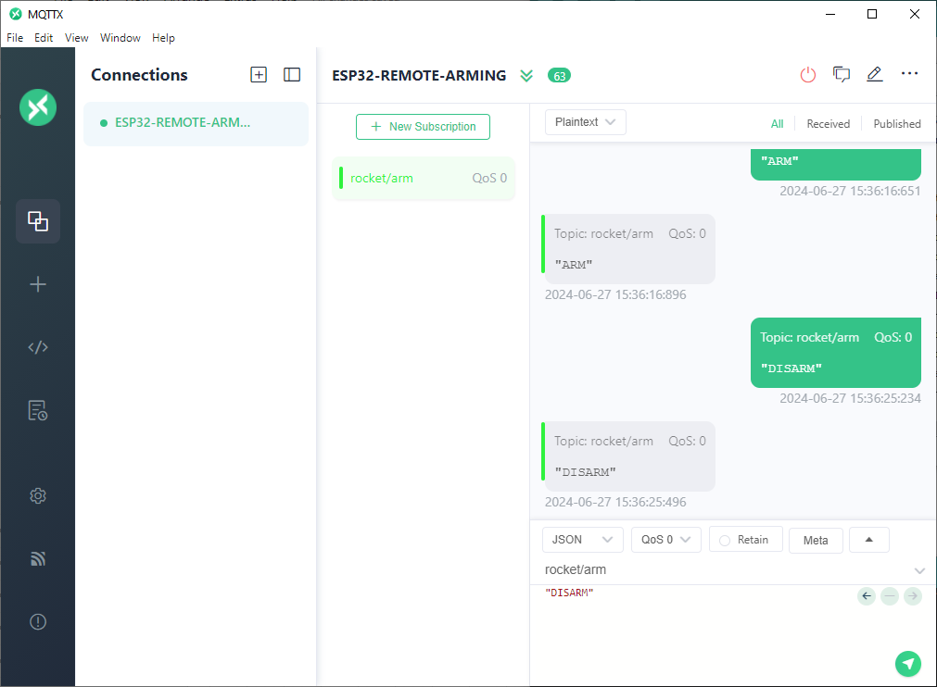
ESP32 REMOTE ARMING

